Slide 1


Project Based Learning
Project By – 1) Mihir S Ponkshe
2) Avaneesh S Pharande
3) Purva Tapare

Slide 2
Welcome to Transportio
Discover a seamless transportation solution that connects you to air, water, and road freight services. Transportio simplifies logistics with real-time booking, digital receipts, and detailed order tracking.

Slide 3
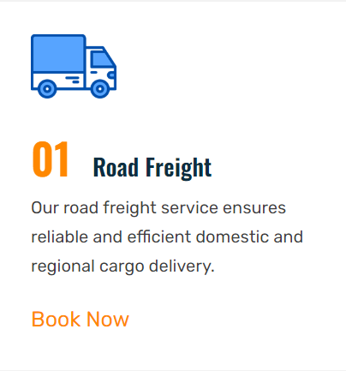
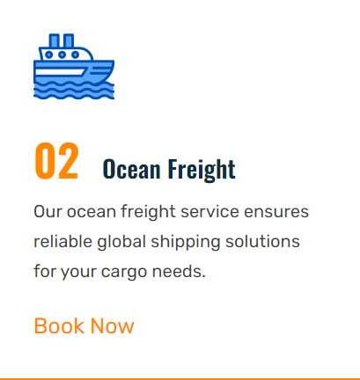

Freight Booking Services
Hassle-Free Booking
Personalized Support
With our user-friendly platform, you can easily book air, water, and road freight services in just a few clicks. Our intuitive interface guides you through the process seamlessly.
Our team of freight experts are available around the clock to assist you with any questions or concerns you may have throughout the booking process.
Flexible Options
Choose from a wide range of freight carriers and service levels to find the perfect fit for your shipping needs, whether it's time-sensitive deliveries or cost-effective solutions.

Slide 4
Air, Water, and Road Freight Options
Air Freight
Water Freight
Road Freight
Multimodal Options
Fast and efficient transportation for time-sensitive cargo. Ideal for high-value items that need to be delivered quickly across long distances.
Cost-effective shipping for large, bulky, or heavy goods. Ideal for international transport of commodities and raw materials.
Flexible and reliable transport for domestic and regional deliveries. Suitable for a wide range of cargo types and sizes.
Combine different transport modes to create customized logistics solutions, optimizing cost, speed, and efficiency.

Slide 5



Downloadable Freight Receipts
Secure Downloads
Detailed Receipts
Record Keeping
Customers can easily download their freight receipts for their records in a secure and convenient manner.
Each freight receipt provides comprehensive details about the shipment, including item description, weight, dimensions, and total cost.
Downloadable receipts allow customers to maintain a digital archive of their past freight transactions for easy reference and tax purposes.

Slide 6
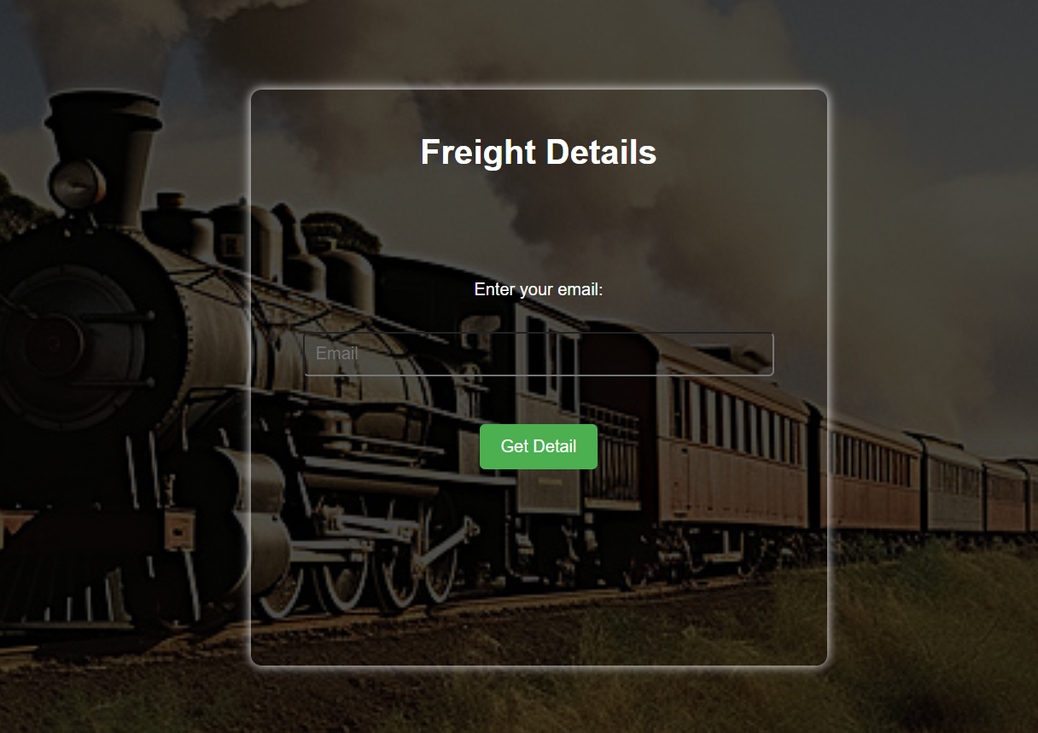
Freight Booking Details via Email
Customers receive a detailed email summary after booking their freight shipment. This email includes the shipment tracking number, pickup and delivery dates, carrier information, and a downloadable PDF receipt.
The email design is clean and modern, using a calming blue and white color scheme to provide a professional and trustworthy experience.

Slide 7

HTML, CSS, JavaScript, and Python Flask Server
Transportio's web application is built using a robust technology stack, including HTML for the structure, CSS for the visuals, and JavaScript for interactivity and dynamic functionality.
The backend is powered by a Python Flask server, which handles the server-side logic, API integrations, and database interactions.
This combination of front-end and back-end technologies ensures a seamless, responsive, and feature-rich user experience for Transportio's freight booking and management services.

Slide 8

MySQL Database Integration
1
Database Design
Carefully plan the database schema to store all the necessary data for Transportio's freight booking services, including customer information, booking details, and order history.
2
Data Storage
Utilize MySQL, a reliable and scalable relational database management system, to securely store and manage all the data related to Transportio's operations.
3
Real-Time Queries
Implement efficient SQL queries to retrieve and update data in real-time, ensuring a seamless user experience when customers view their booking details or download receipts.

Slide 9
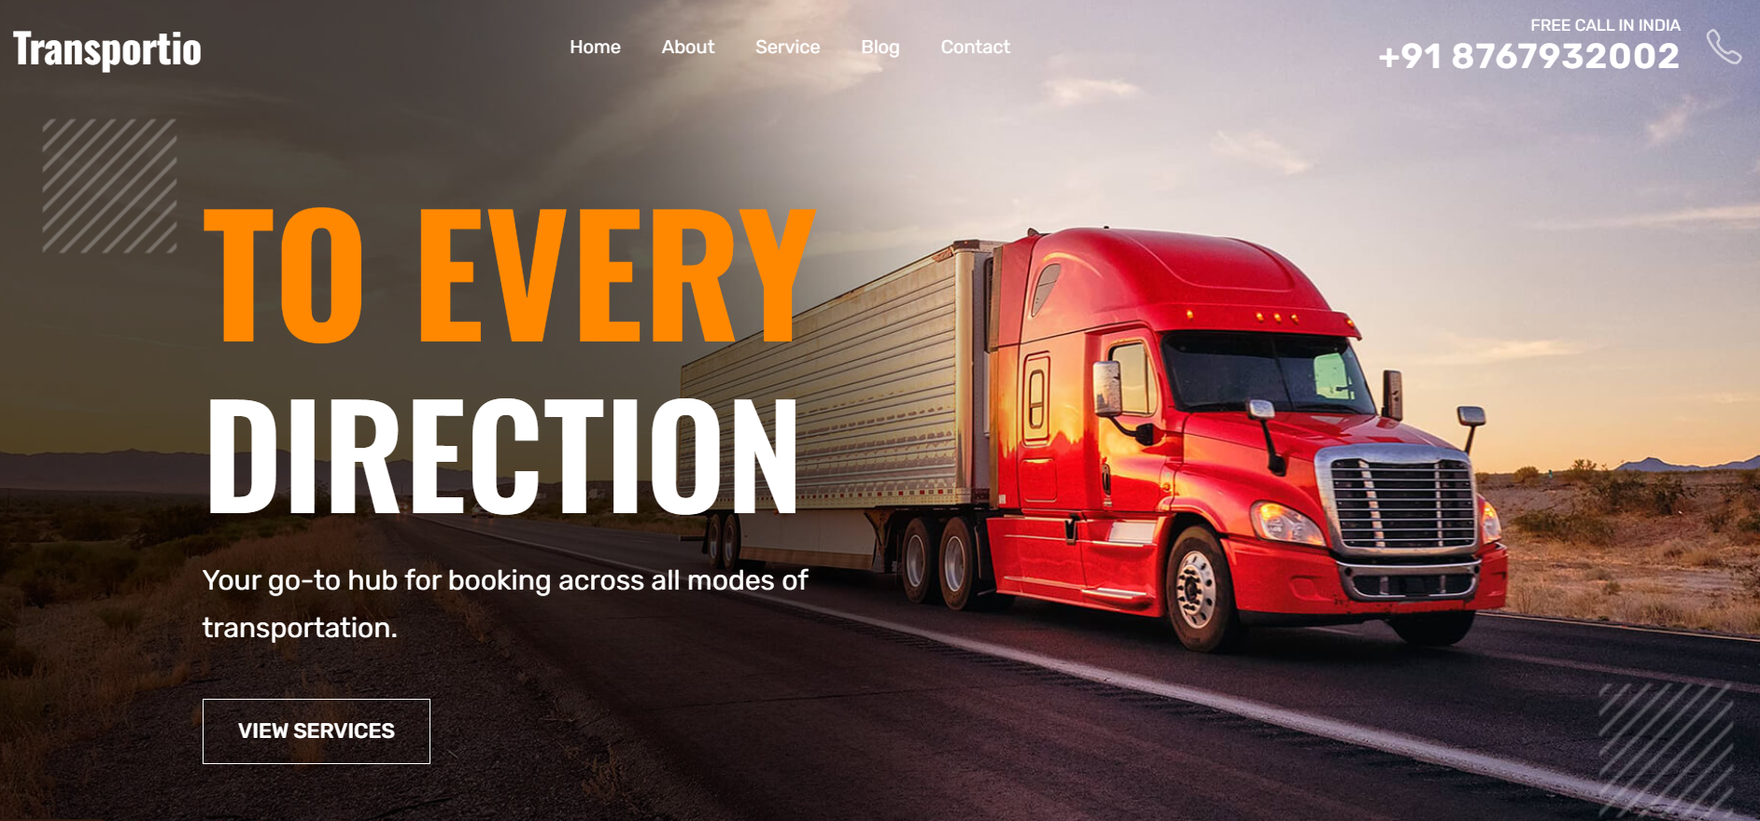
Visually Appealing User Interface
Transportio's user interface is designed with a modern, clean aesthetic that enhances the user experience. Intuitive navigation, clear calls-to-action, and well-organized information create a seamless booking process for air, water, and road freight.
Vibrant imagery, typography, and color palette work together to establish a visually striking yet approachable brand identity that sets Transportio apart in the freight industry.

Slide 10
Contact and Email Us Features
Easy-to-Use Contact Form
Detailed Email Support
Transportio's user-friendly contact form allows customers to easily send inquiries, feedback, or support requests directly to the team.
Customers can expect a prompt and personalized email response from the Transportio team, addressing their questions or concerns.
Multilingual Communication
Responsive and Reliable
The contact and email features support multiple languages, ensuring seamless communication with customers around the world.
The contact and email systems are designed to be highly responsive and reliable, providing customers with a smooth and hassle-free experience.

Slide 11

Thank You
As we wrap up our journey through Transportio, we extend our heartfelt gratitude for your time and interest. This presentation has provided a comprehensive overview of our innovative freight booking platform, from its robust features to its visually stunning design. We hope you've gained valuable insights and are excited about the possibilities Transportio can offer your business.

